Slide 1
Software Product Line Engineering in Safety-critical Domains

Slide 2
1 Motivation

Slide 3
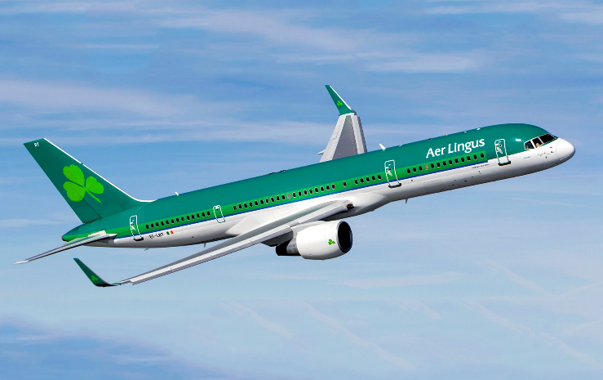
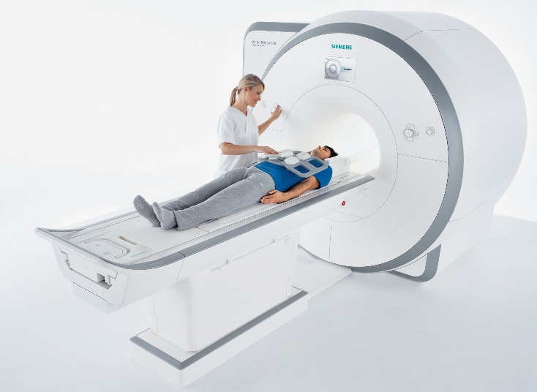
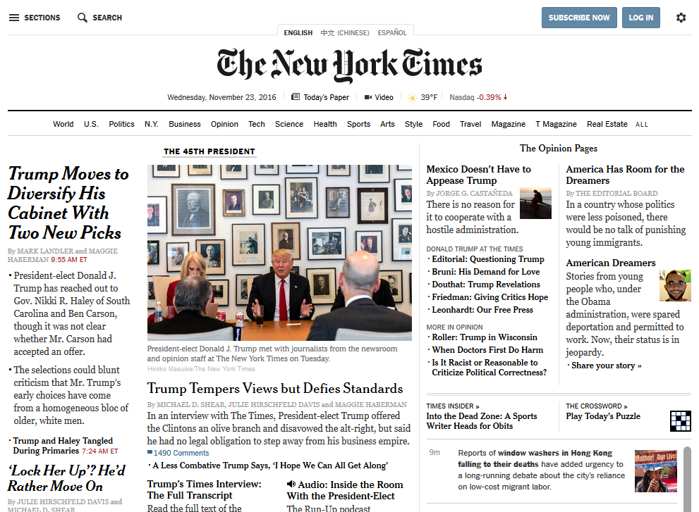
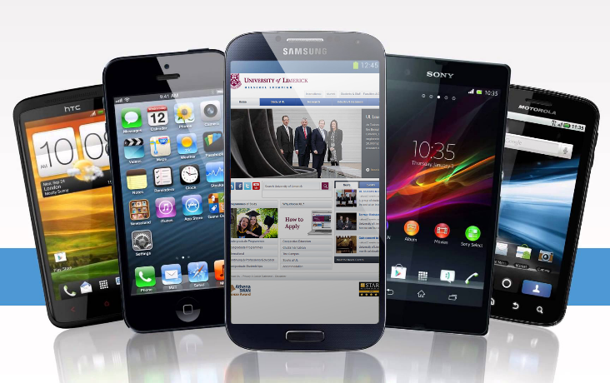
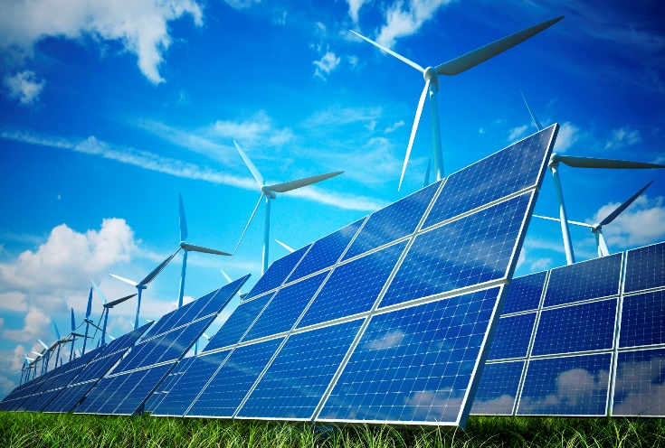
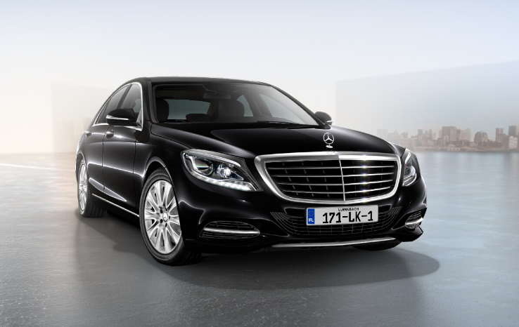
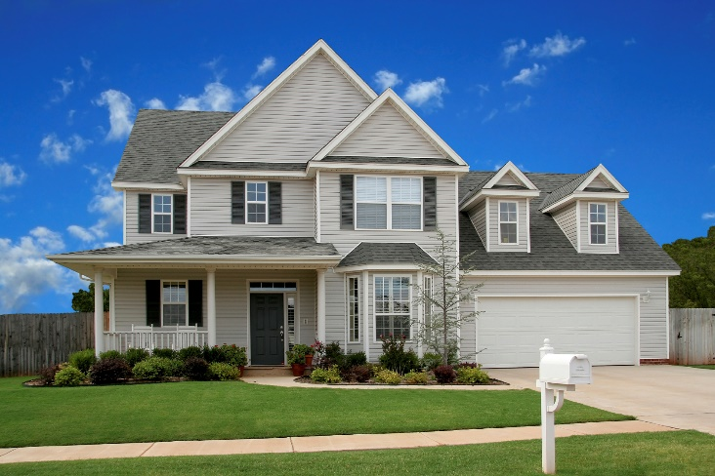
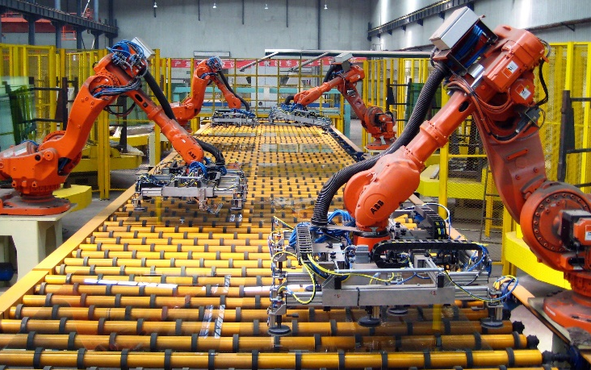
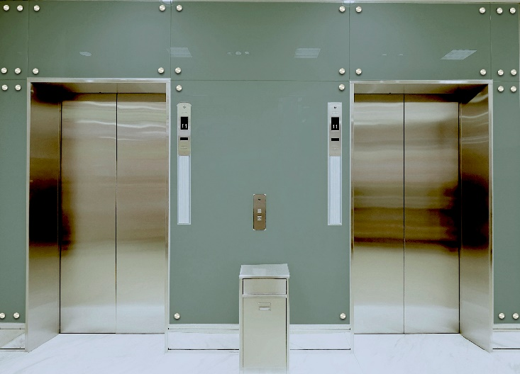
~150 Million lines of code
~100 ECUs (Electronic Control Units)
Notes:
What do we see here? There’s a plane, an MRI scanner, a house, a car, …
But what I actually see is software systems. Any system in our everyday life will become a software system.
Complex
150 Mio LOC. One thousand times as much as …
100 ECU, little computers
Many different aspects to consider, e.g., fuel consumption, safety, cost of manufacturing How do we build such a complicated system?

Slide 4
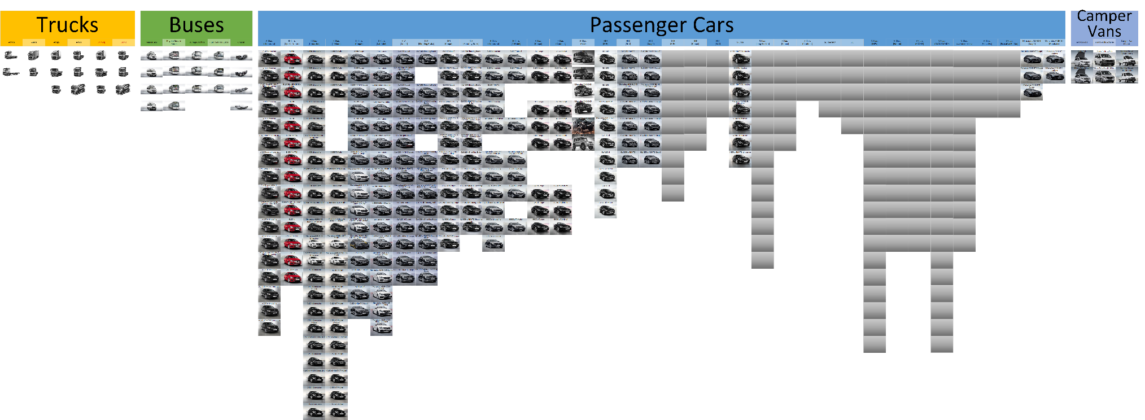
Many Variants
Source: Product info and configurators on http://www.mercedes.de
Notes:
Did not expand all the variants of trucks and buses.
And that is just the current new models that you can buy right now. We are not even considering

Slide 5
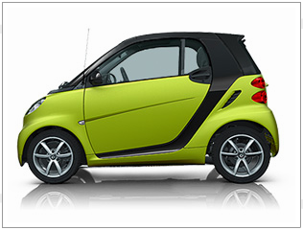
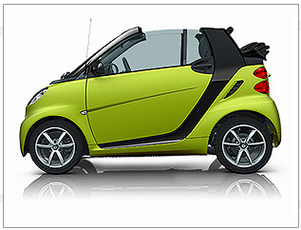
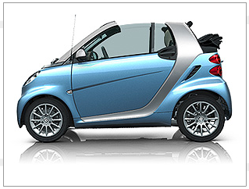
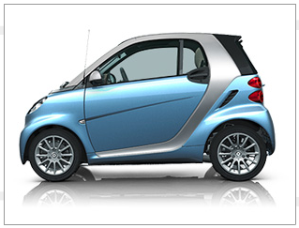
Origin of Product Lines
Sucessful Product → More Products → Product Portfolio
Few systems are truely unique
Strategic Reuse

Slide 6
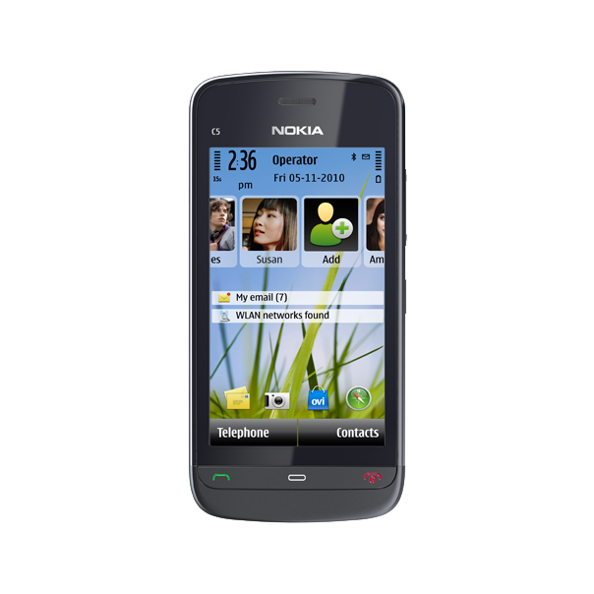
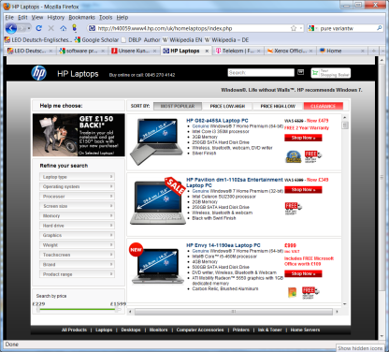
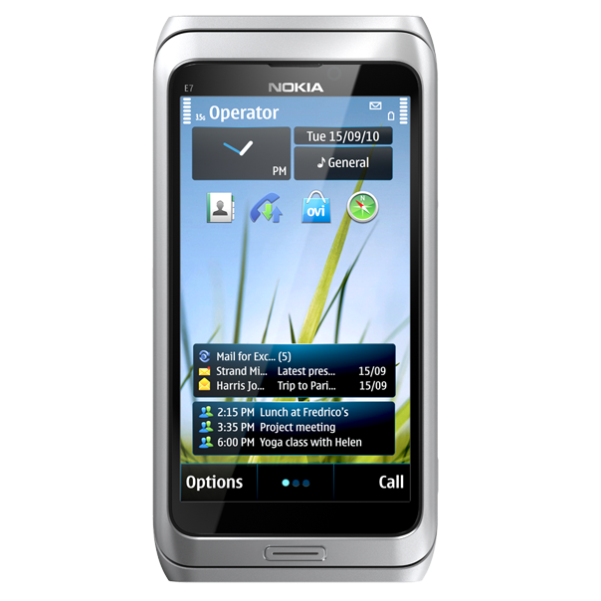
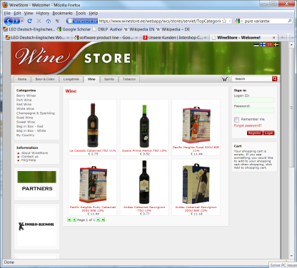
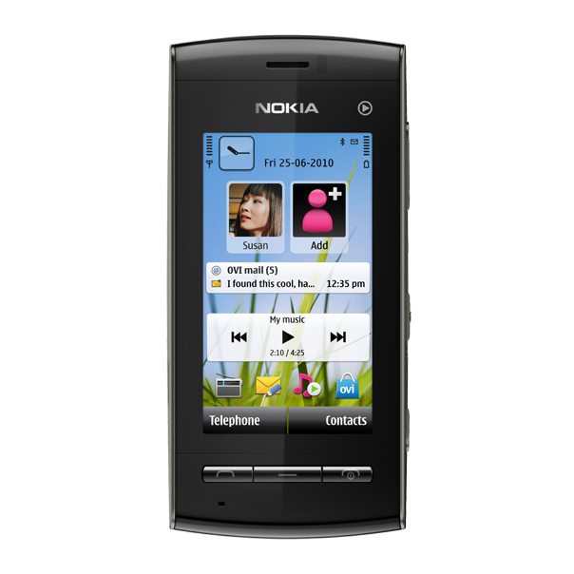
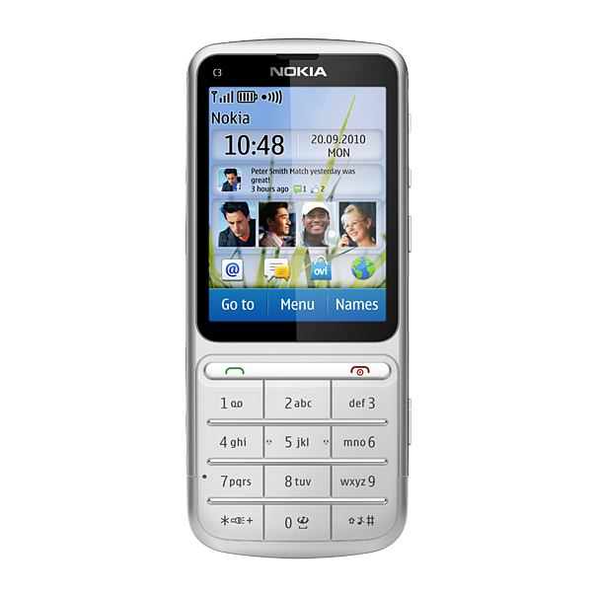
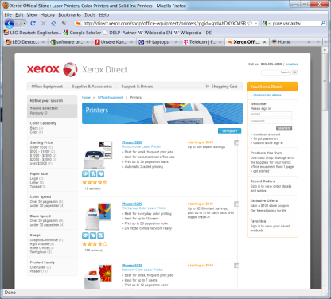
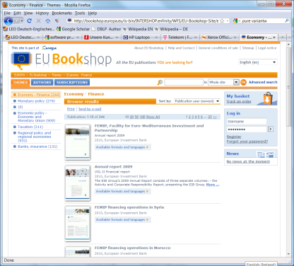
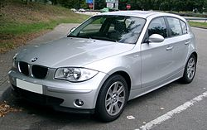
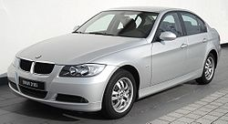
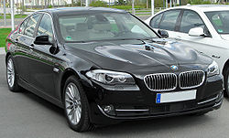
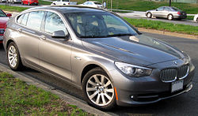
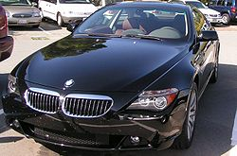
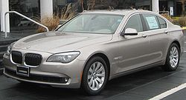
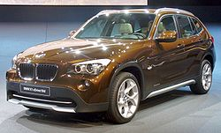
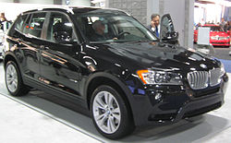
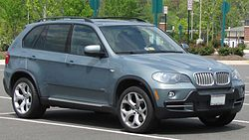
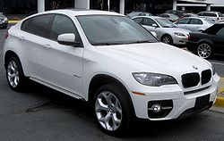
Product Lines

Slide 7
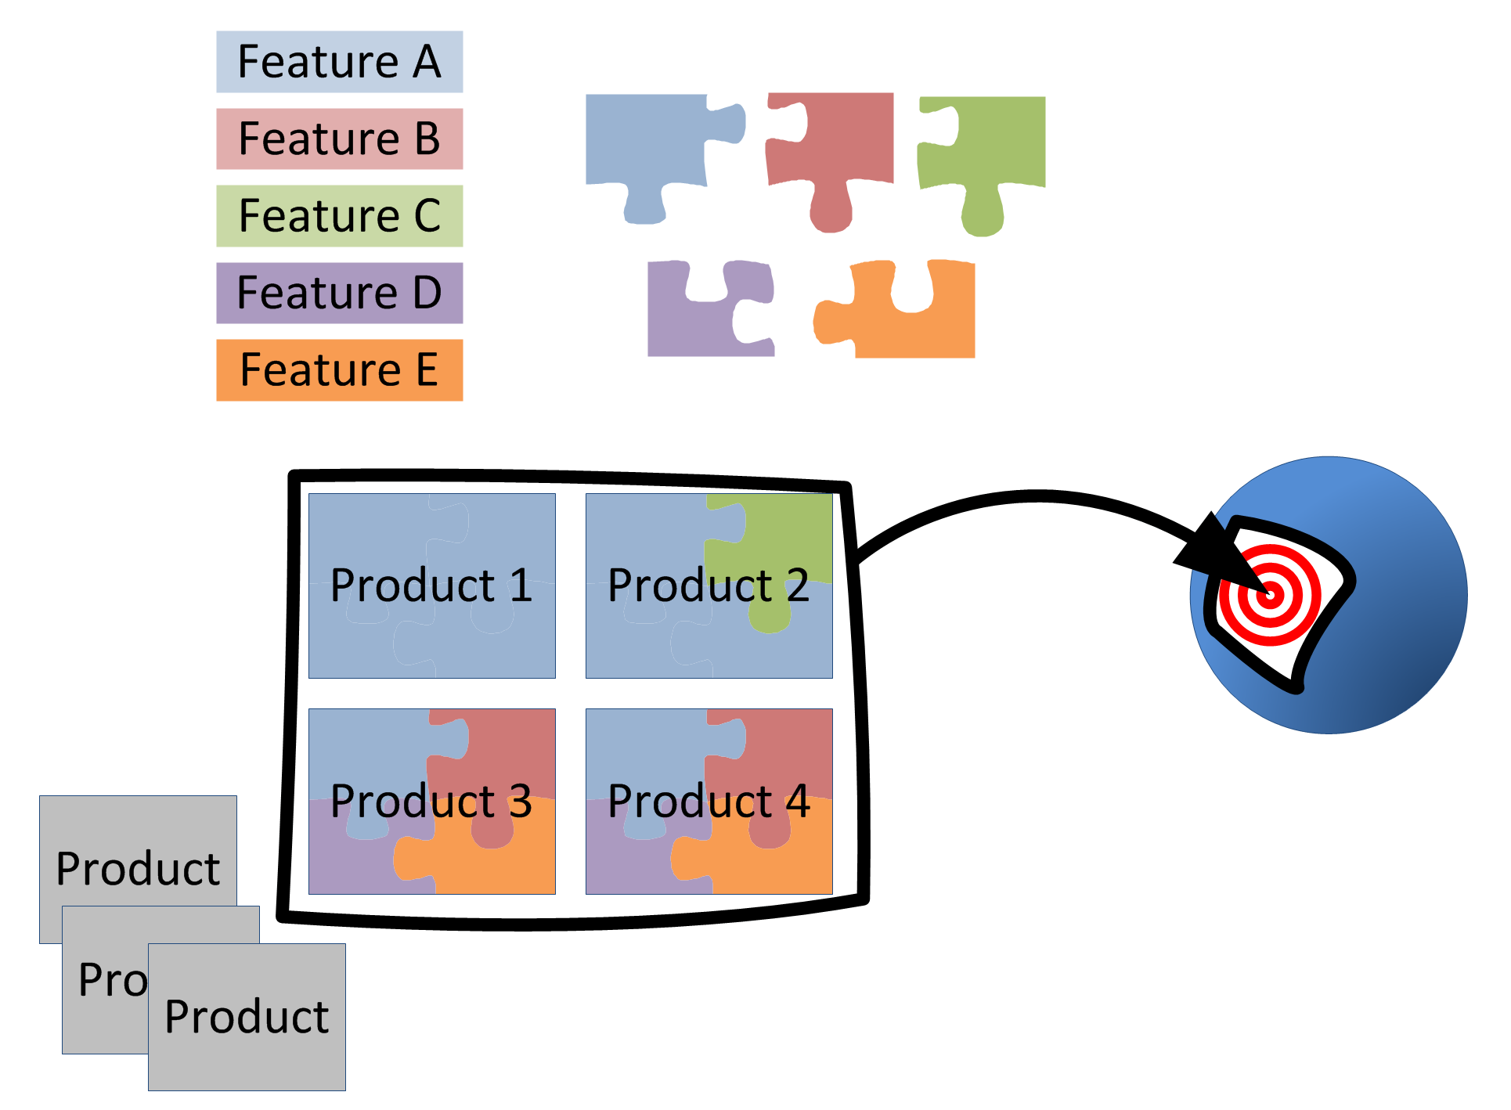
Product Lines
Sharing a common, managed set of features
Developed from a common set of core assets in a prescribed way (strategic reuse)
Targeting a market segment (scope)
Set of software intensive systems
[Clements and Northrop 2002]

Slide 8
Benefits of Product Lines
High quality
Reduced time to market
Market dominance
Market agility
Product alignment
Low cost production
Low cost maintenance
Mass customization
Reduced maintenance effort
Improved Efficiency and Productivity
[Clements and Northrop 2002, Northrop 2008]

Slide 9
Other effects
Scalability and complexity handling
Managment of evolution
Improved cost and time estimation

Slide 10
Prerequisuites
Enabling technologies: configuration/assembly of products (e.g. for software: OO, components, binding, ...)
Process maturity
Domain
Stability
Expertise, predictive knowledge
Otherwise: return on investment not possible

Slide 11
2 Software Product Line Engineering (Example of a Framework)

Slide 12
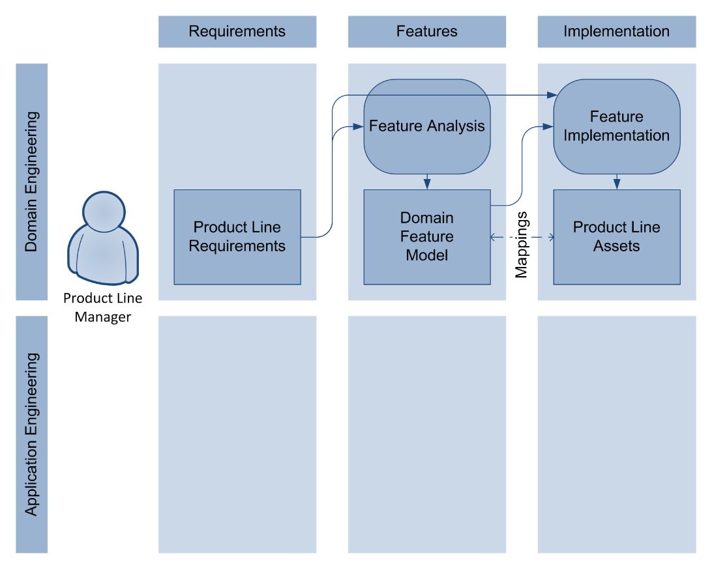
Product Line Engineering: Domain Engineering

Slide 13
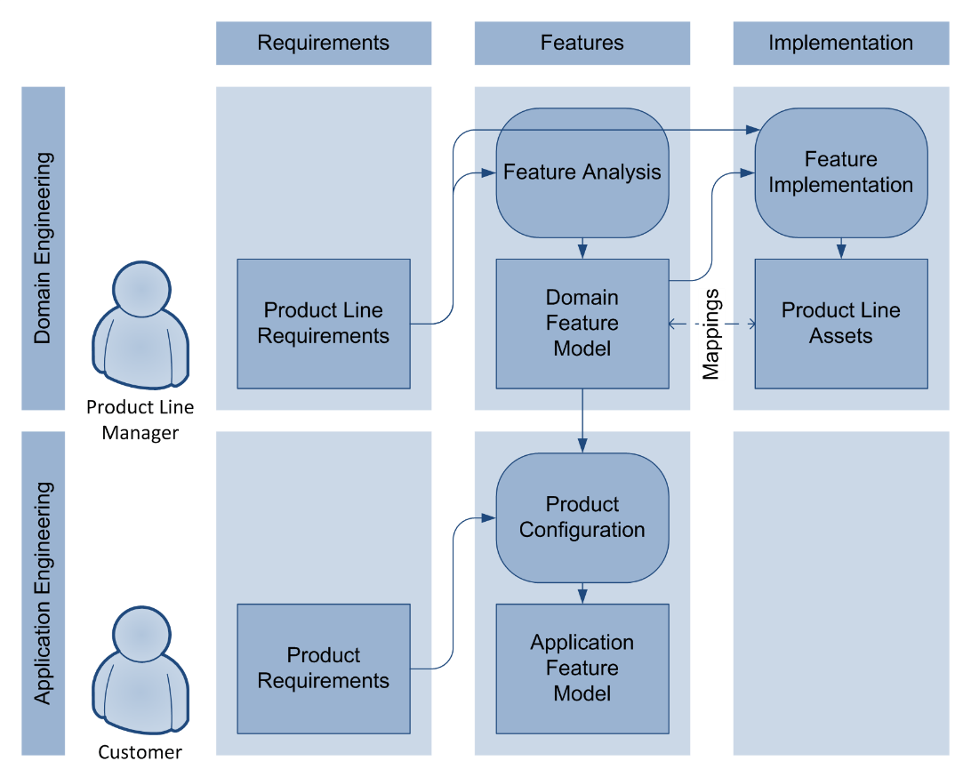
Product Line Engineering: Application Engineering

Slide 14
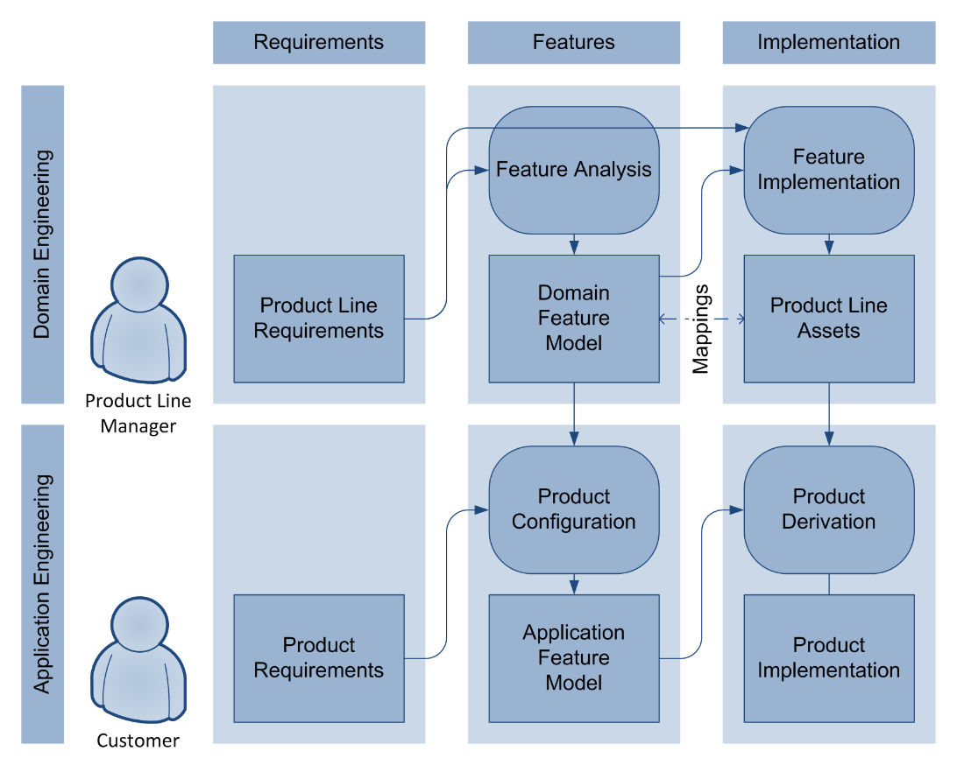
Product Line Engineering: Application Engineering

Slide 15
Product Line Engineering
Product Line Architecture
Product Line Assets

Slide 16
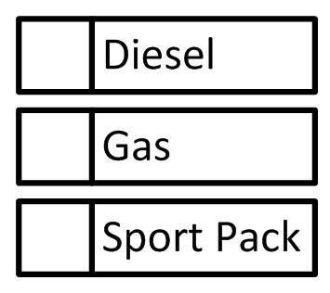
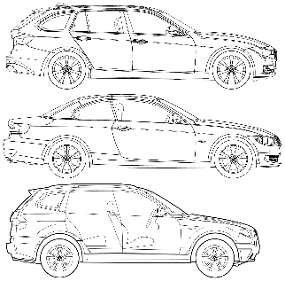
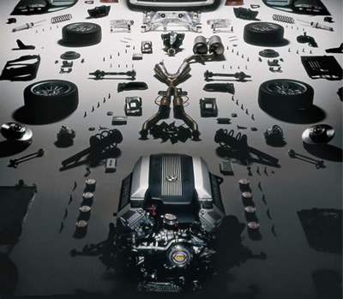
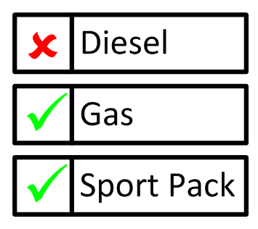
Product Line Engineering
Product Line Architecture
Product Line Assets

Slide 17
Product Line Engineering
Mapping required

Slide 18
3 Transition to SPLE

Slide 19
Different Approaches to Product Lines
Proactive
Develop PL assets first
Scoping, predictable target segment required
Upfront investment
Opportunity to structure PL and architecture as a whole
Reactive
Develop products first
Derive PL from products
Related approaches: Mining/Reverse Engineering
Incremental
Develop the PL in phases
Can be combine with both proactive and reactive approach

Slide 20
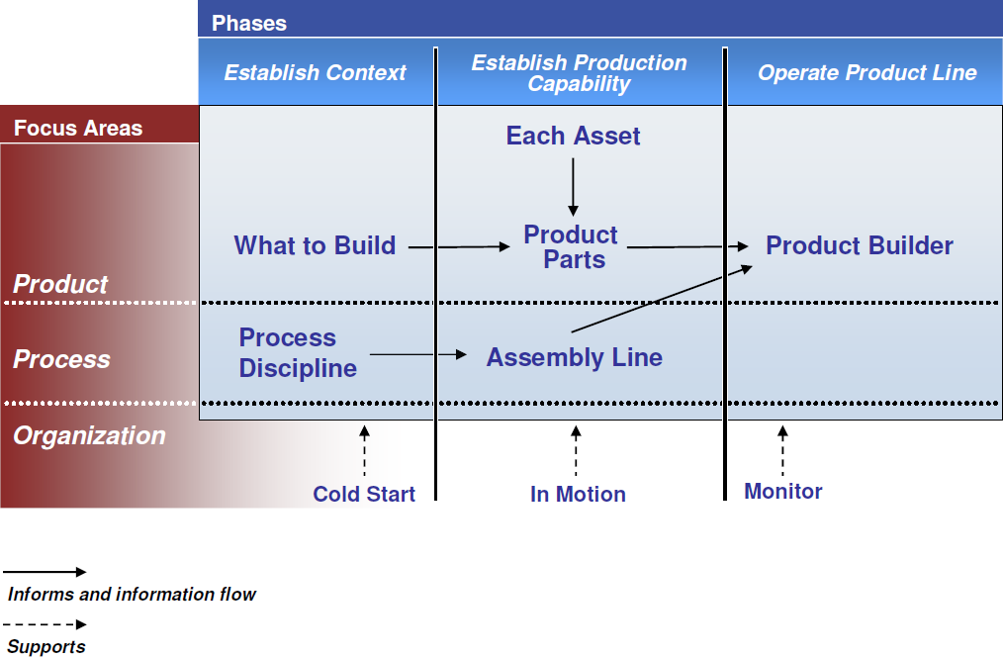
SEI Adoption Factory Pattern
[Clements et al. 2006, Northrop 2008]

Slide 21
4 Product Line Evolution

Slide 22
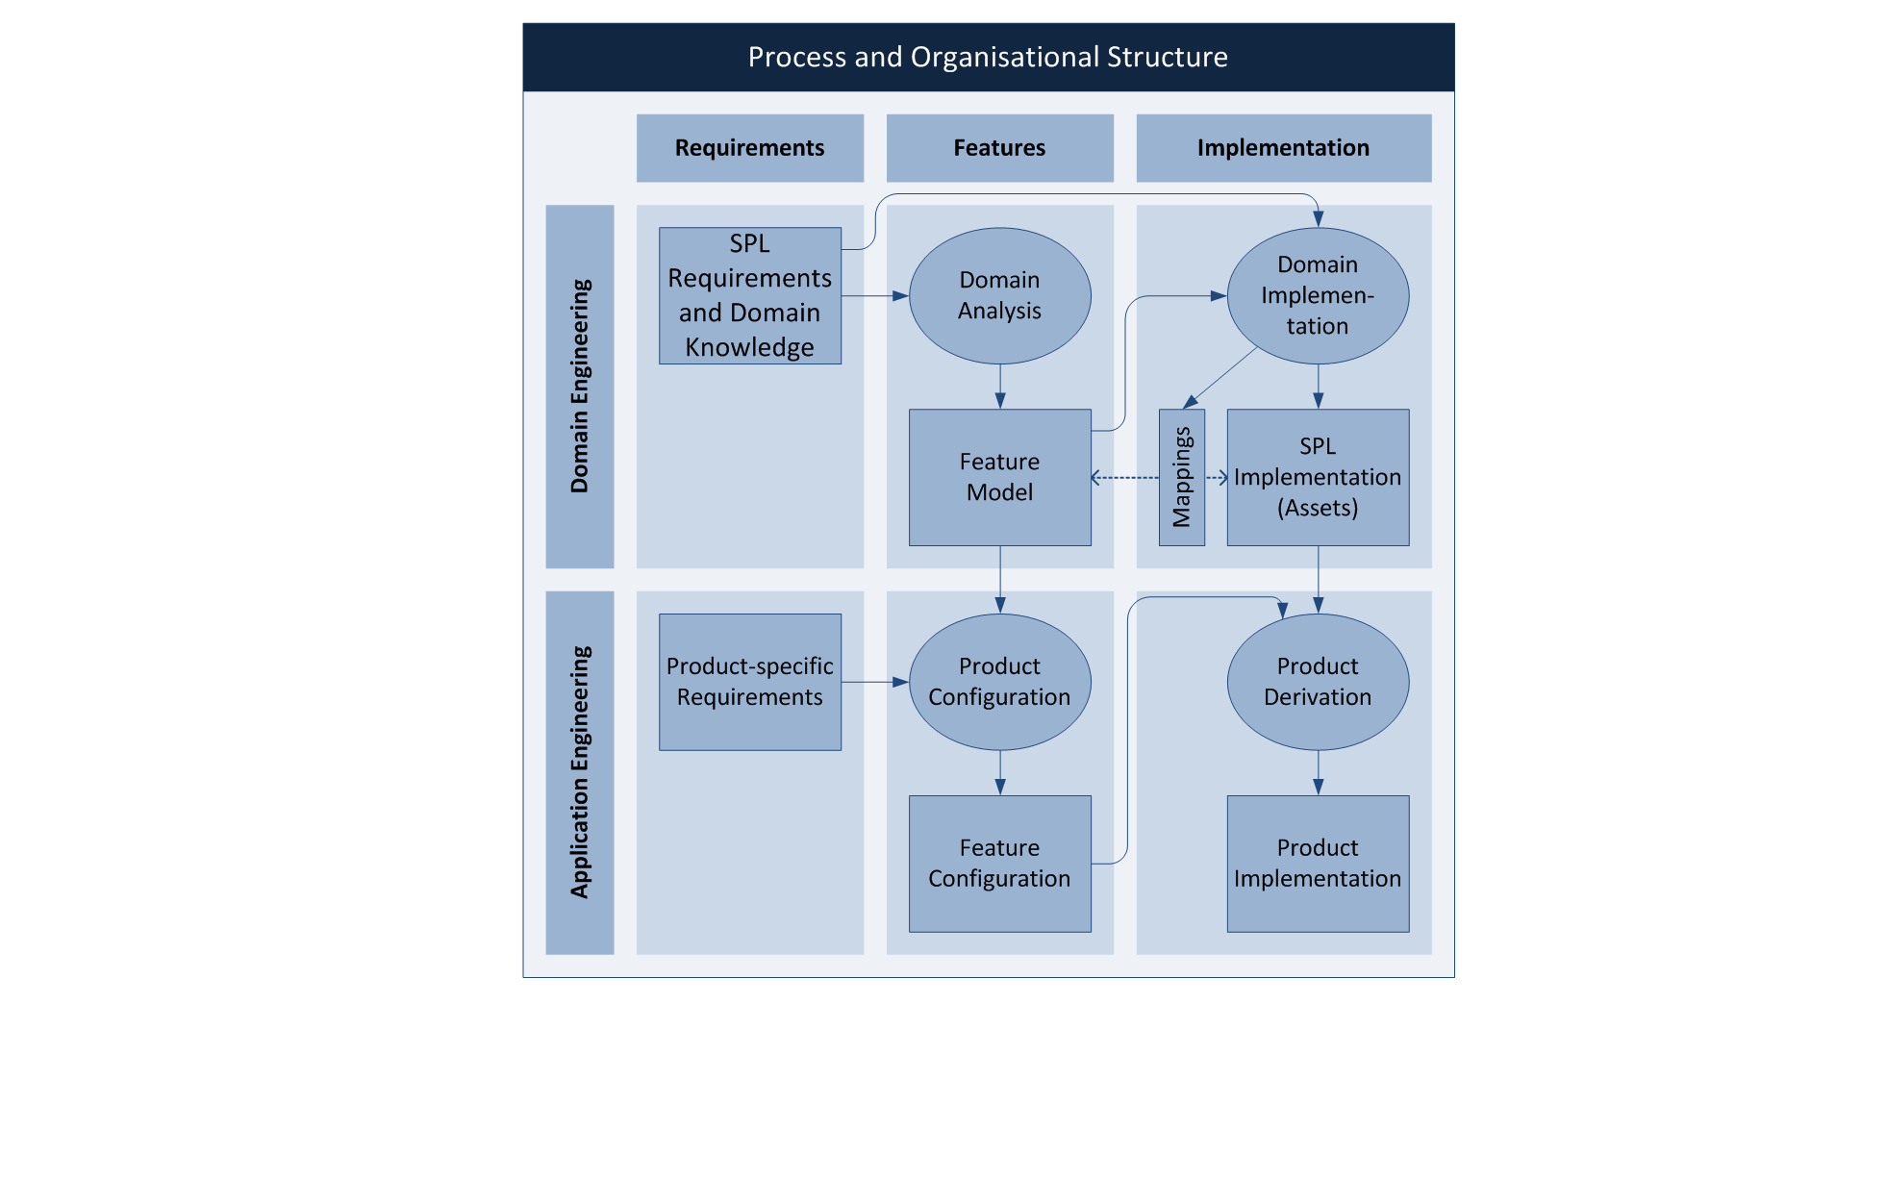
Product Line Evolution
[Botterweck and Pleuss 2014]

Slide 23
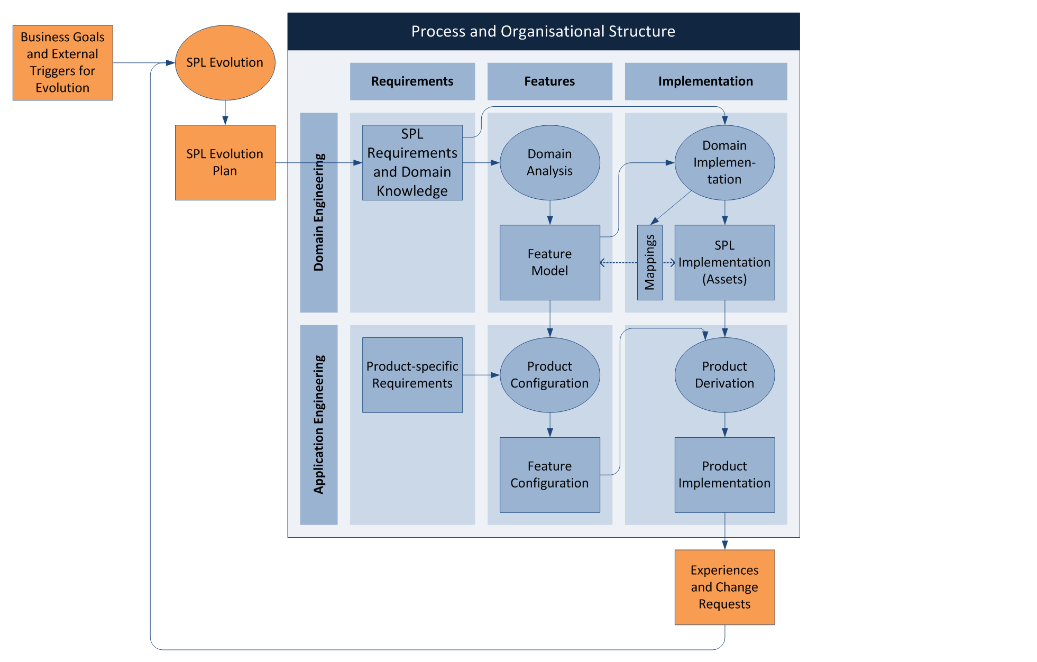
Product Line Evolution
[Botterweck and Pleuss 2014]

Slide 24
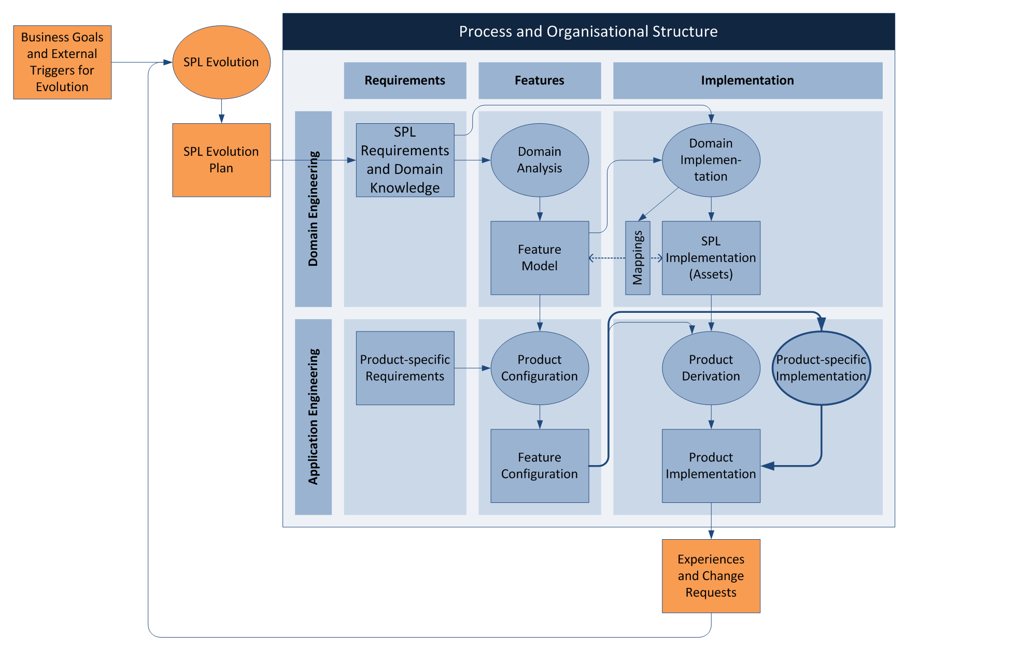
Product Line Evolution
[Botterweck and Pleuss 2014]

Slide 25
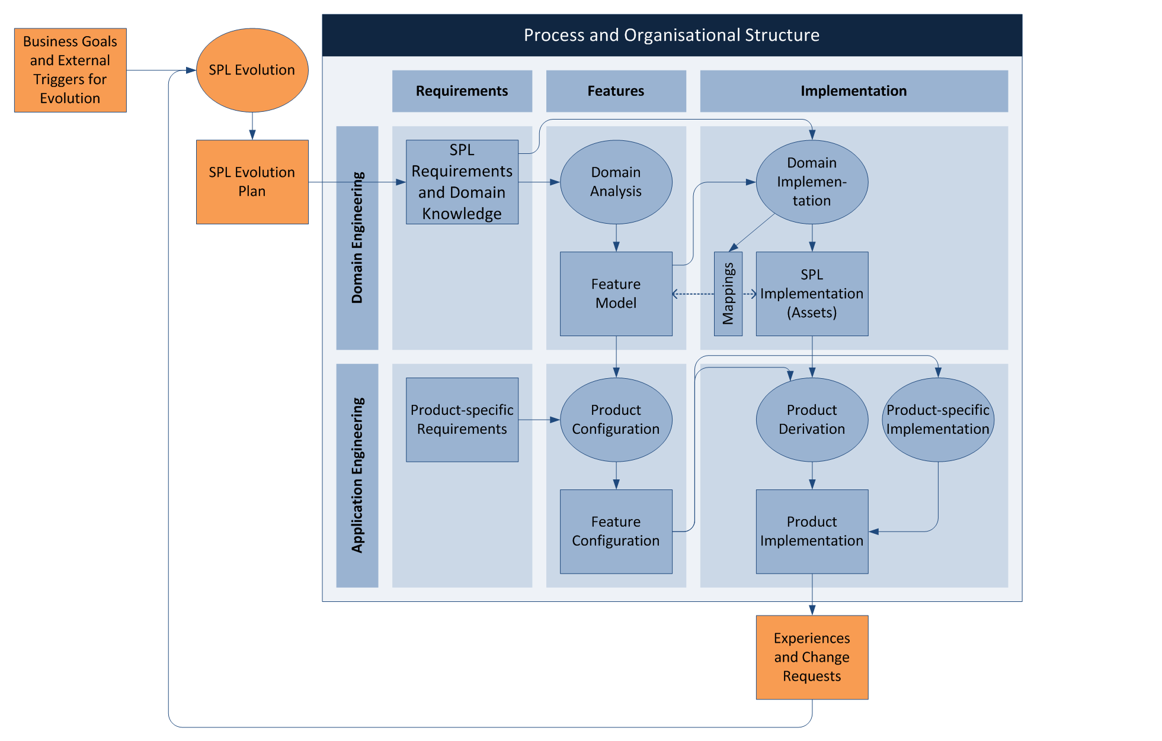
Product Line Evolution
[Botterweck and Pleuss 2014]

Slide 26
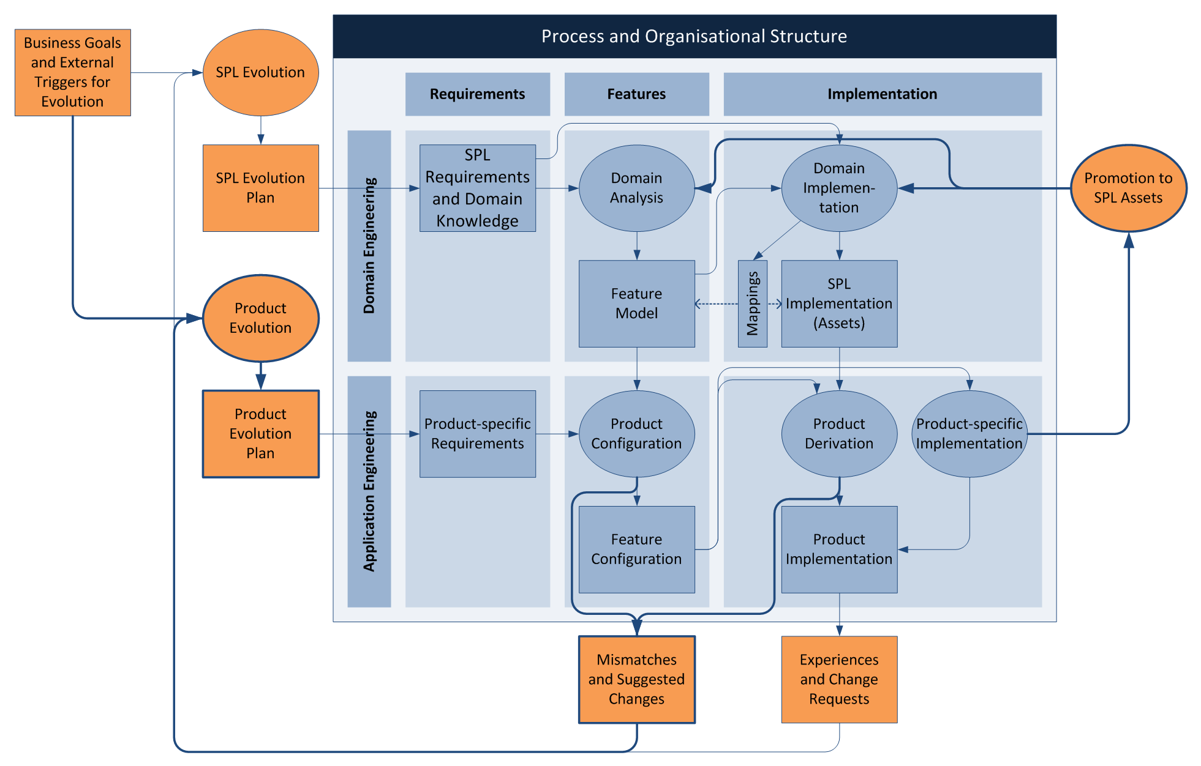
Product Line Evolution
[Botterweck and Pleuss 2014]

Slide 27

Product Line Evolution
[Botterweck and Pleuss 2014]

Slide 28
5 Variation/Automation and Quality

Slide 29
6 Successful in Practice

Slide 30
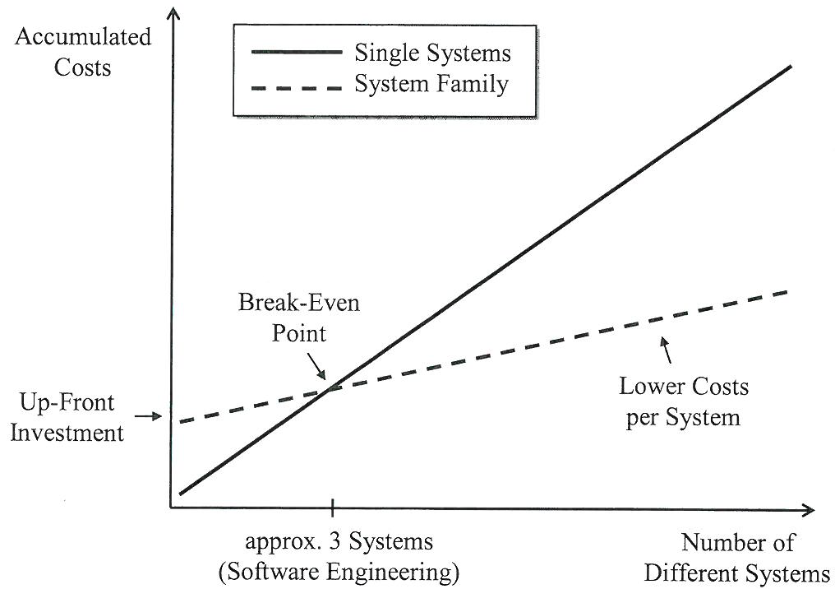
Develoment Costs
[Pohl et al. 2005, Weiss and Lai 1999]

Slide 31
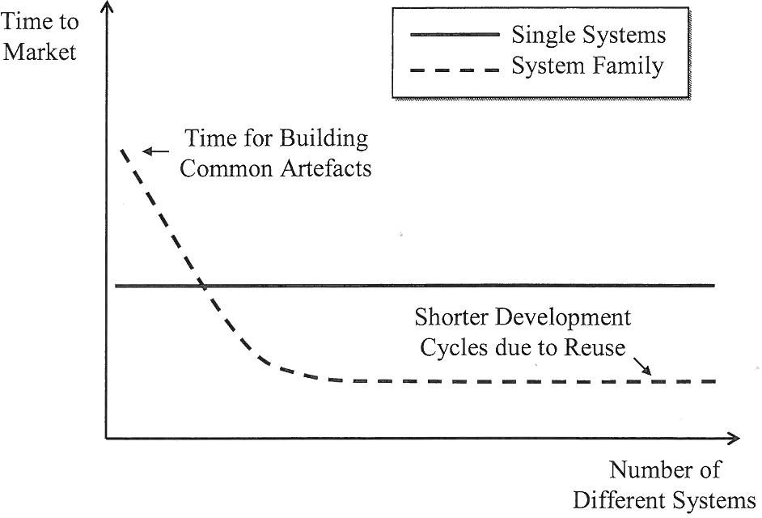
Time-to-market
[Pohl et al. 2005]

Slide 32
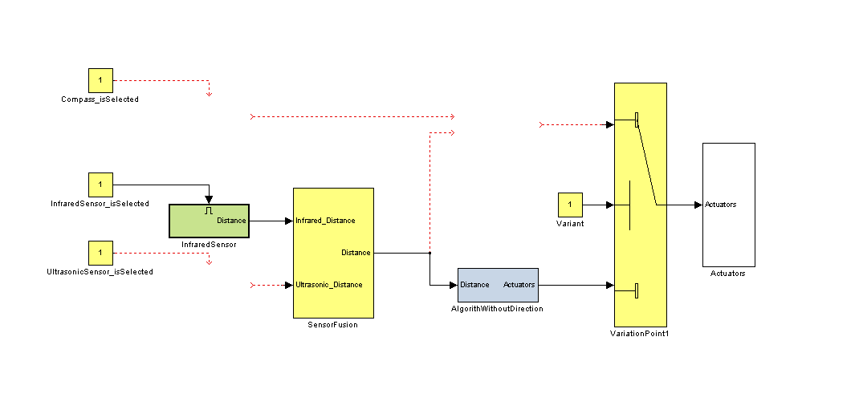
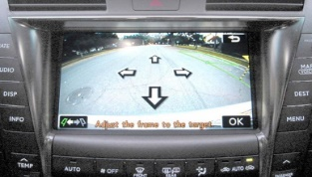



Sucessful applied in practice
Product lines have been used sucessfully used, for instance, for
Avionics Systems
Engine Control Software
Marine Command and Control Systems
Telecommication Systems
Printer Firmware
RAID Storage Controllers
Financial Software
Mobile Phones
Medical Systems
Consumer Electronics
Acquisition Management Systems
Power Systems

Slide 33
5 Current Research

